Slide 1

GIS for Geoscientists Session 1: Projections
Image Credit: Patrick Kennelly, Montana Bureau of Mines and Geology
Presented by Nicholas Barber, 3rd Year PhD Student at the University of Cambridge, U.K.
ndb38@cam.ac.uk | www.volcannick.com | https://github.com/ndb38 | Twitter @volcannick

Slide 2
Coordinates & Projections
We use coordinates to define the “where” on a map
Easting and Northing (Projected Coordinate System)
X and Y (Projected Coordinate System)
Latitude and Longitude (Geographic Coordinate System)
However, defining where something is may not be straightforward
Maps are a flat surface, and the earth is 3D. There is inherently distortion converting coordinates from 3D to 2D
Need to consider that the Earth is not a sphere
Error in spatial measurements
Physical location of an object changes through time

Slide 3
Coordinates & Projections
The coordinates of a spatial object depends on
A reference system (or datum) defining shape of the Earth
A projection, or mathematical transformation from spherical --> Cartesian coordinates
The error inherent in the measurement of the feature
The change of position with respect to time or space
In defining a coordinate system, you essentially want to be able to convert between X, Y, Z in 2D space and Lat, Long, Height in spherical space
No spatial analysis can be done accurately without this very important step!!

Slide 4
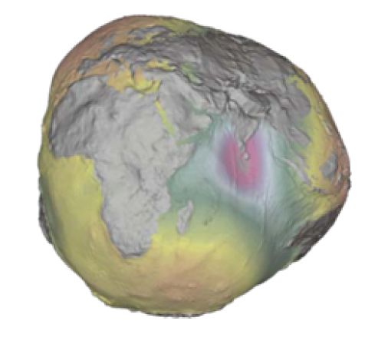
Defining the Reference System
Pythagoras, Aristotle reasoned Earth must be a sphere
Eratosthenes (276 -194 BCE, Libya) measured circumference of the Earth to within 4% of modern accepted value
Ptolemy (90-168 CE, Egypt) set the accepted standard shape of the Earth
Aryabhatta (476-550 CE, Bihar, India) got within 70 miles of correct equatorial circumference
Abu Rayhan Biruni (973-1048 CE, Uzbekistan) held most accurate measurements of Earth’s radius until the Enlightenment in Europe
18th century saw geographers characterize Earth as an ellipsoid rather than a sphere
Clarke and Bessel ellipsoids popular in 19th century NA and Europe, respectively
“We define the geoid as the three-dimensional
equipotential surface, along which the
pull of gravity is a specified constant” – Bolstad Ch. 3

Slide 5

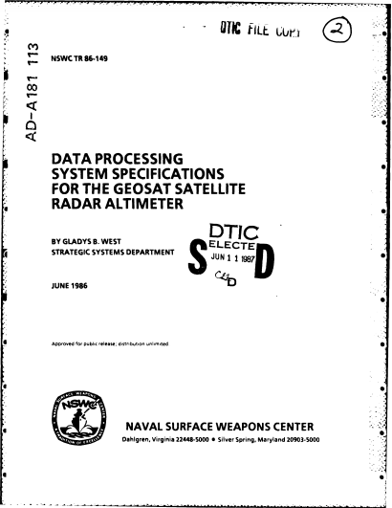

“She programmed an IBM 7030 Stretch computer, which was significantly faster than other machines at the time, to provide calculations for an accurate geodetic Earth model. This detailed mathematical model of the shape of the Earth was a building block for what would become the GPS orbit.” - The Guardian

Slide 6
Coordinates & Projections
We reference the geoid as our “zero-height” 3D baseline for spatial locations on, above, or below Earth
Geoid defined by gravity, and is fixed regardless of atmospheric or oceanic processes
We start with horizontal and vertical reference systems, or datums, to define the position of an object relative to the ellipsoid
There are several main ellipsoids to choose from (e.g. WGS84)
Next, we define the projection system, which converts our ellipsoidally-referenced positions to a flat, 2D map.
This is where the dizzying array of projection systems comes in!
Choice of projection has been a topic of recent debate and controversy

Slide 7
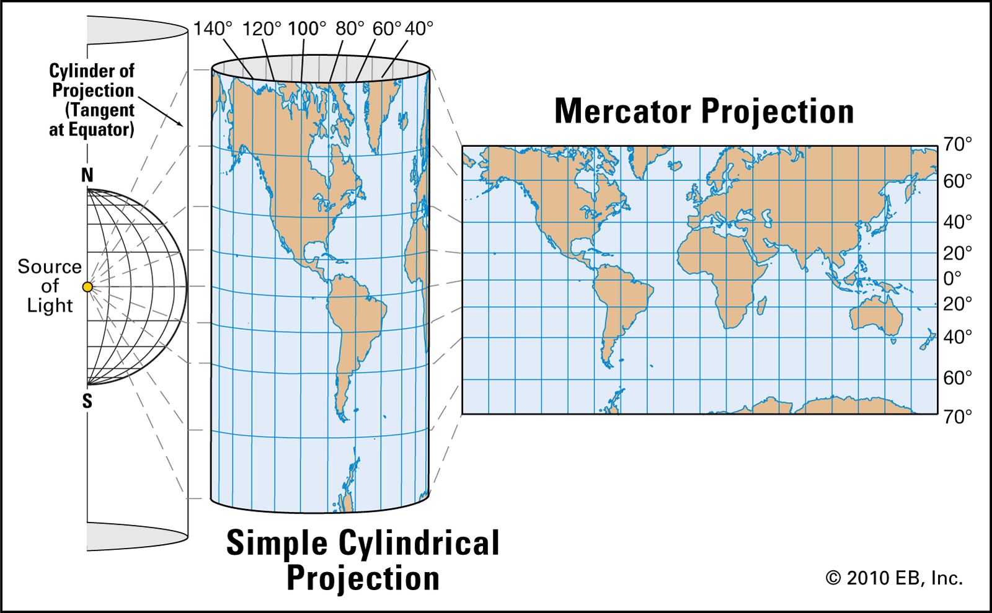
Mercator Projection System
Defined by Gerardus Mercator in 1569
Cylindrical map projection
The gold standard for 16th century navigation because it preserves local directions and shapes
Also known as a conformal projection: every angle between two curves that cross each other is preserved in the final map
Side Effect: increasingly inflates the size of objects away from the equator
Became the preferred world map projection in 19th and 20th centuries

Slide 8
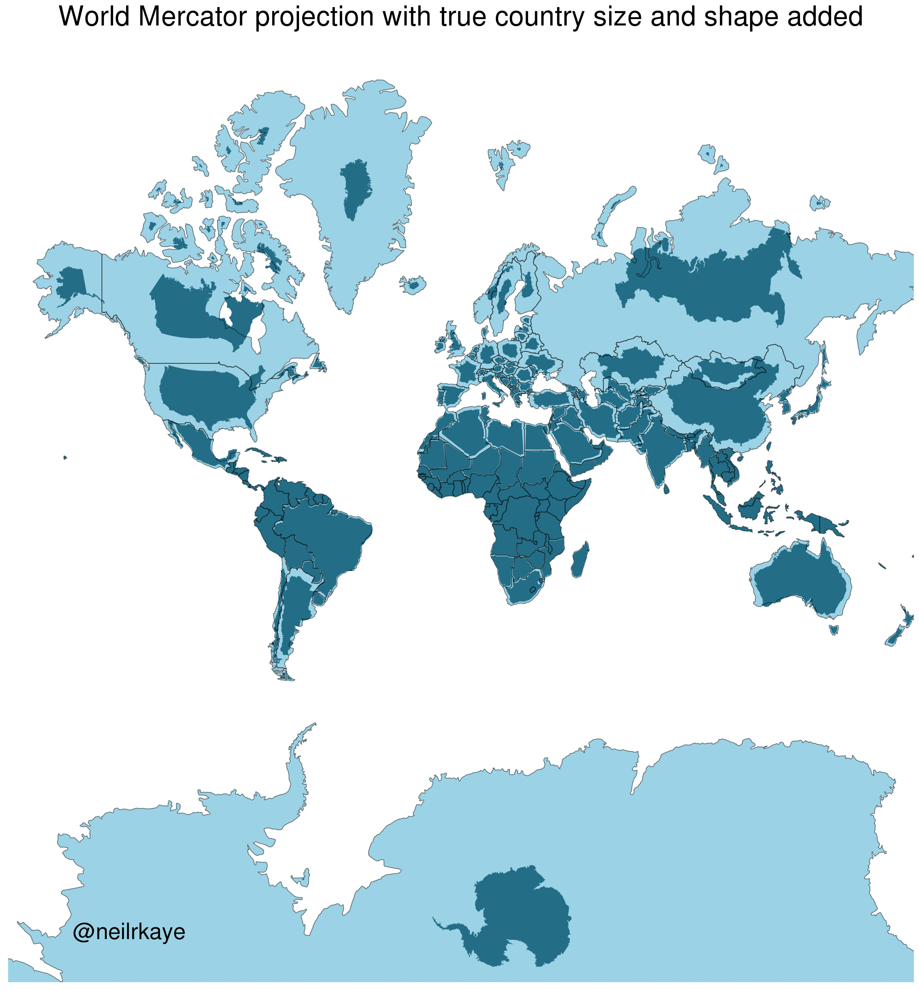

Slide 9
www.thetruesizeof.com

